Slide 1


Weight & Biases
with
Run:ai

Slide 2
Weights & Biases background

Slide 3

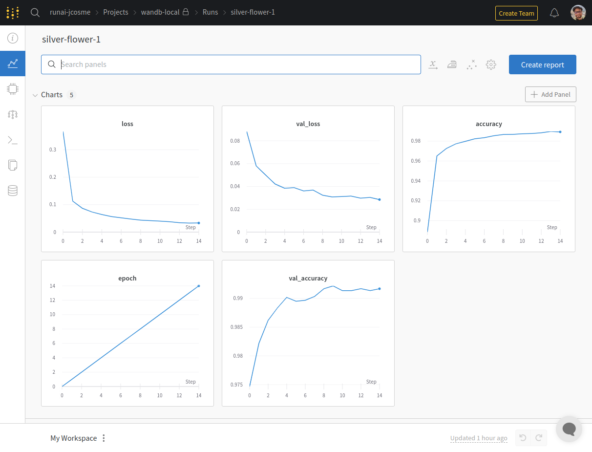

How does W&B work?
wandb.ai
(your environment)
(python script)
wandb

Slide 4
What is needed for W&B to run?
1) An account with W&B
2) The “wandb” package installed
3) A .netrc file (create by running “wandb login” command)
4) wandb code within your python script

Slide 5
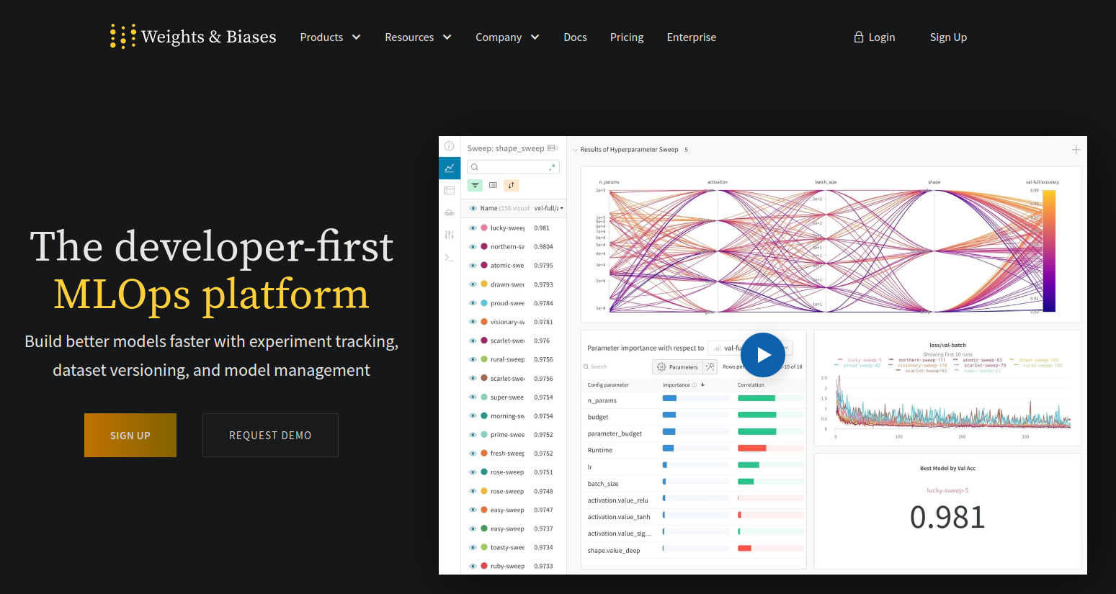
Step 1: Create account with W&B
Navigate to “wandb.ai” on your browser and select “Sign Up”

Slide 6
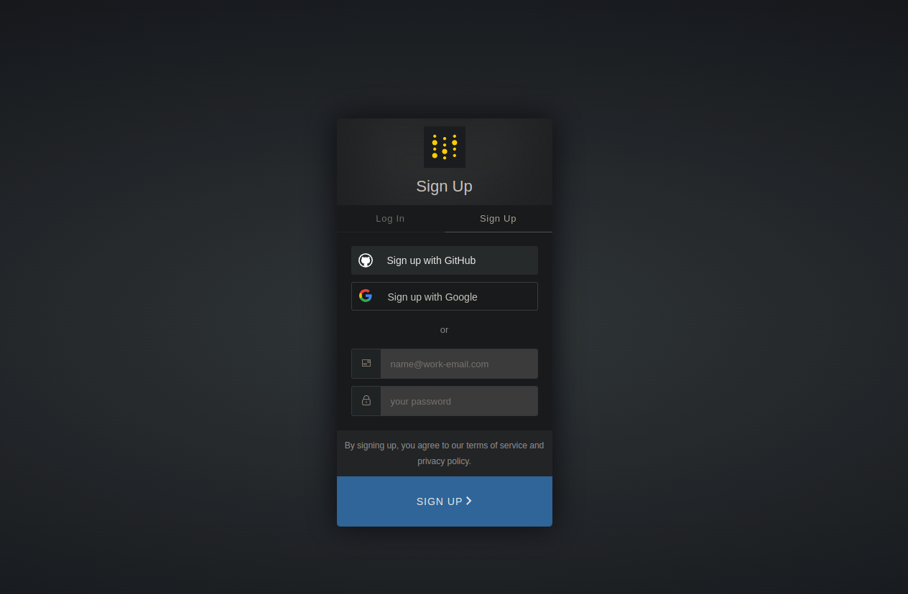
Step 1: Create account with W&B
Follow steps to register

Slide 7
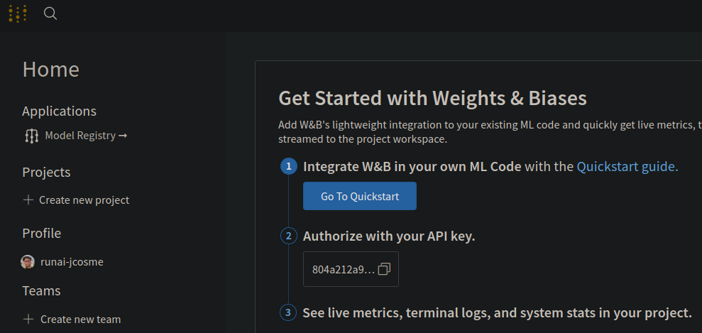
Step 1: Create account with W&B
After registering, click on the W&B icon on the top left. You’ll notice and API key.
This will be used in step 3
1
2

Slide 8
Step 2: Install “wandb” package
We can install wandb with conda.
Here is an example command where we create an environment called “wandb-env” and install the “wandb” package along with Tensorflow
mamba create -n wandb-env -c conda-forge wandb tensorflow tensorflow-gpu -y

Slide 9
Step 3: .netrc file
The .netrc file is created after running “wandb login” command.
The .netrc file is always created in the home directory (~/.netrc)
When running wandb within your code, it will always look for the .netrc file in the home directory (~/.netrc)

Slide 10
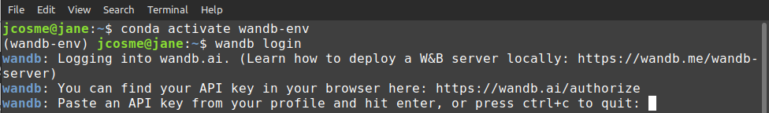
Step 3: .netrc file
Run the “wandb login” command
wandb login
Copy the API key from your W&B account page...
...then paste it into the terminal (and hit enter)

Slide 11
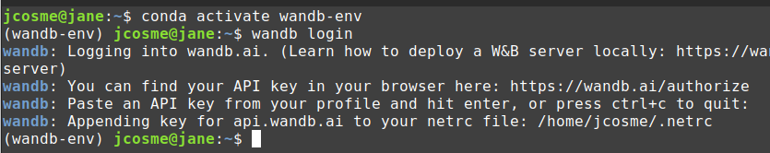
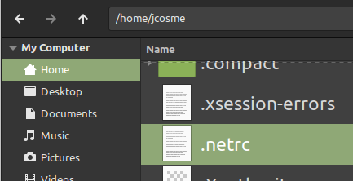
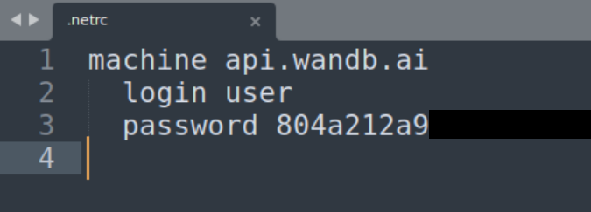
Step 3: .netrc file
A file will be created in your home directory (~/) called “.netrc” (~/.netrc)
The .netrc file is a text file containing your API key
W&B references this file in order to interface with your wandb.ai account.
You will no longer need to run the “wandb login” command.

Slide 12
Step 4: wandb code in your script
Here are the highlights of the wandb code within our python script
import wandb
from wandb.keras import WandbCallback
from tensorflow import keras
from tensorflow.keras import layers
wandb.init(project="wandb-local")
wandb.config = {
"learning_rate": 0.001,
"epochs": 15,
"batch_size": 128
}
# (load data here)
# (build model)
# (continued on next block)...
# ... (continued from previous block)
opt = keras.optimizers.Adam(
learning_rate=wandb.config['learning_rate']
)
model.compile(
loss="categorical_crossentropy",
optimizer=opt,
metrics=["accuracy"]
)
model.fit(
x_train,
y_train,
validation_split=0.1,
batch_size=wandb.config['batch_size'],
epochs=wandb.config['epochs'],
callbacks=[WandbCallback()],
)
For more info on how to use wandb code in your scripts, visit docs.wandb.ai

Slide 13
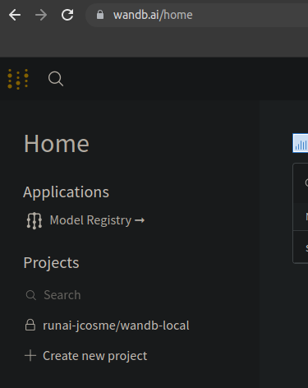
Step 4: wandb code in your script
1
After the script finishes running, refresh your web browser, select the W&B icon on the top left, and you will be able to see the project
2
3

Slide 14
Setting up
W&B with run:ai

Slide 15
What is needed for run:ai to work with W&B?
1) An account with W&B
2) A docker image with wandb installed
3) A persistent .netrc file
4) wandb code within your python script

Slide 16
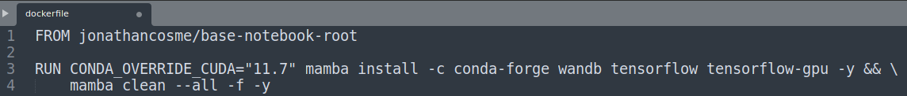
Step 2: Docker image with wandb installed
The docker image we will be using is “jonathancosme/base-root-wandb-tf”*
It is publicly available here:
hub.docker.com/r/jonathancosme/base-root-wandb-tf
This is the dockerfile
This is where we the installation of wandb is speficied
*This image uses “jonathancosme/base-notebook-root” as a base image, which is a slight modification of the official “jupyter/base-notebook” image.
More information can be found here: github.com/jonathancosme/jupyter-base-notebook-root

Slide 17
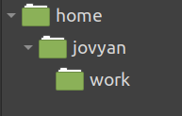
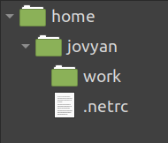
Step 3: Persistent netrc file
about wandb login command:
The home directory in our image is /home/jovyan
Therefore, the .netrc file will be created as /home/jovyan/.netrc
(before we run wandb login)
(after we run wandb login)
wandb will always look for that file in that location

Slide 18
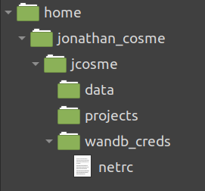
Step 3: Persistent netrc file
we want to create a persistent copy of the netrc file on our NFS...
...so that we can mount that file in our image, when we run jobs
persistent storage (NFS)
image
wandb_creds
wandb
netrc
.netrc

Slide 19
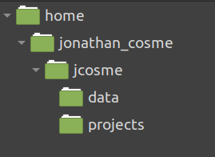
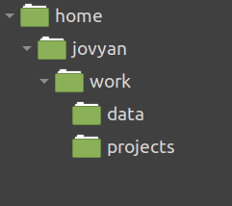
Step 3: Persistent netrc file
how do we create a persistent netrc file?
1. mount our NFS to the jupyter work directory
(NFS)
(jupyter)

Slide 20
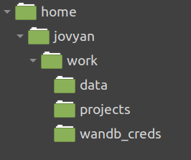
Step 3: Persistent netrc file
how do we create a persistent netrc file?
2. Create the wandb_creds folder in the mounted directory

Slide 21
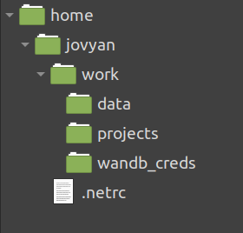
Step 3: Persistent netrc file
how do we create a persistent netrc file?
3. Create the .netrc file (with wandb login command)

Slide 22
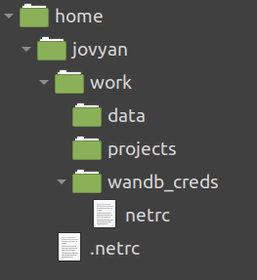
Step 3: Persistent netrc file
how do we create a persistent netrc file?
3. Copy .netrc file to created wandb_creds folder

Slide 23
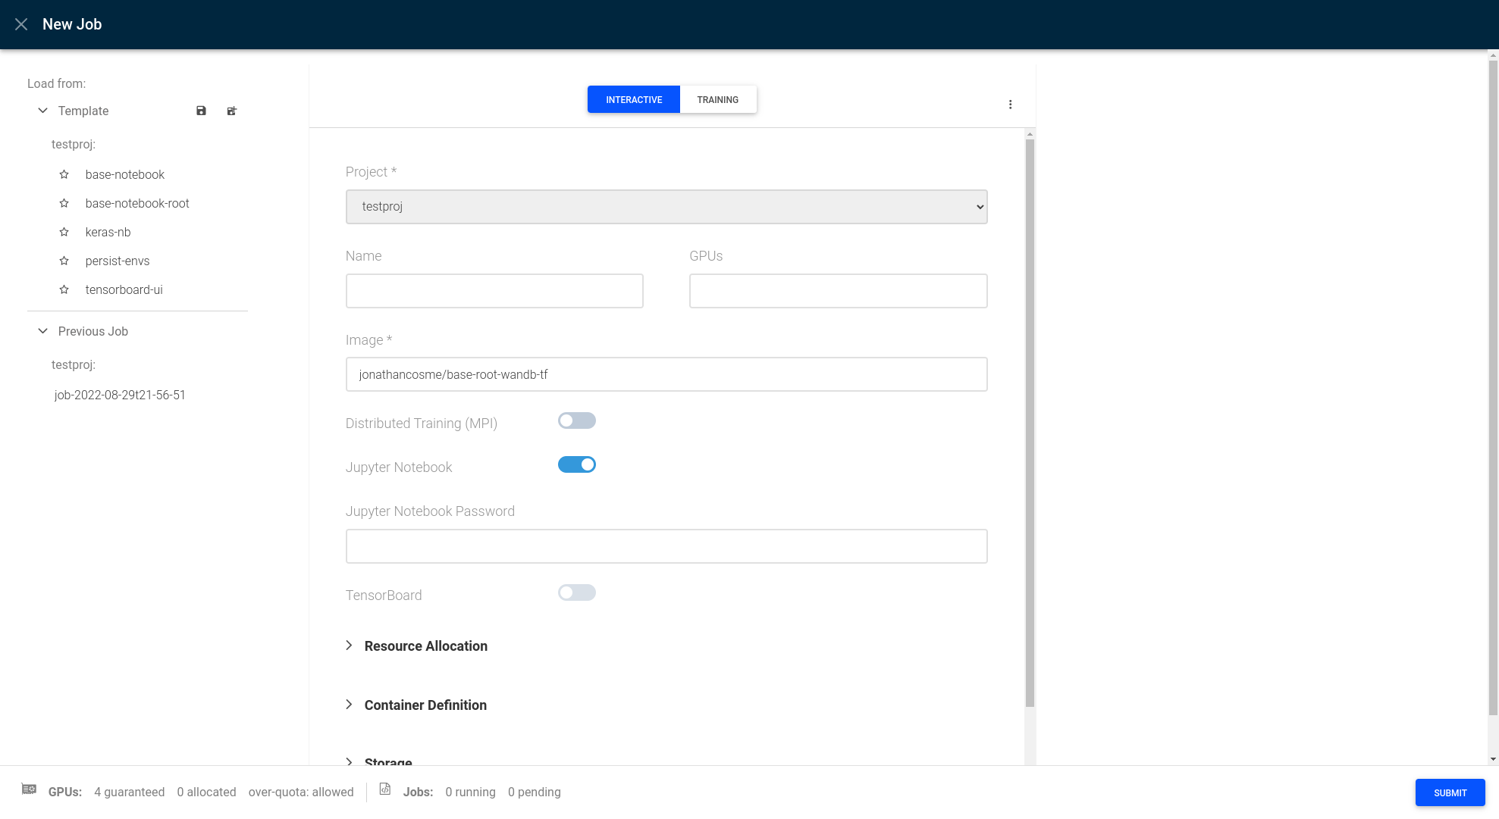
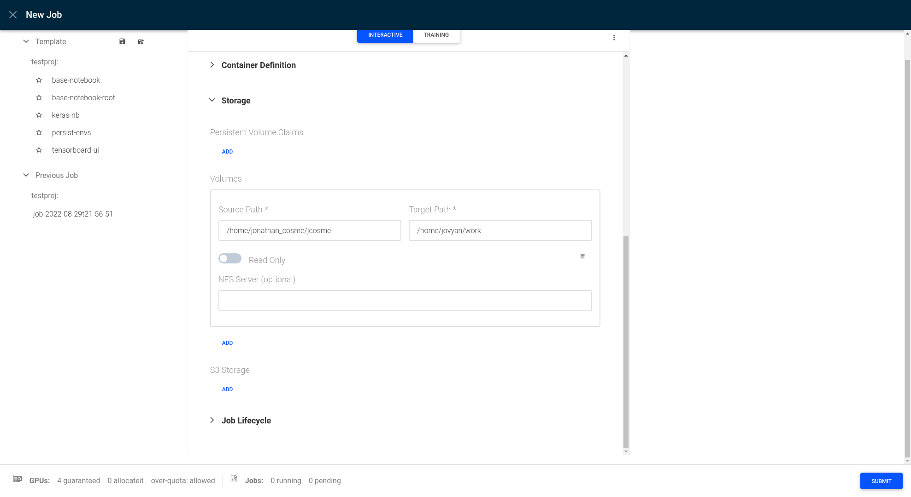
Step 3: Persistent .netrc file
First, we’ll need to mount our NFS directory into the /home/jovyan/work directory of our image
On the UI, create a new interactive job with the
jonathancosme/base-root-wandb-tf image...
...and mount our NFS to the default work directory
NFS folder
default jupyter work directory
(this is always the same)

Slide 24
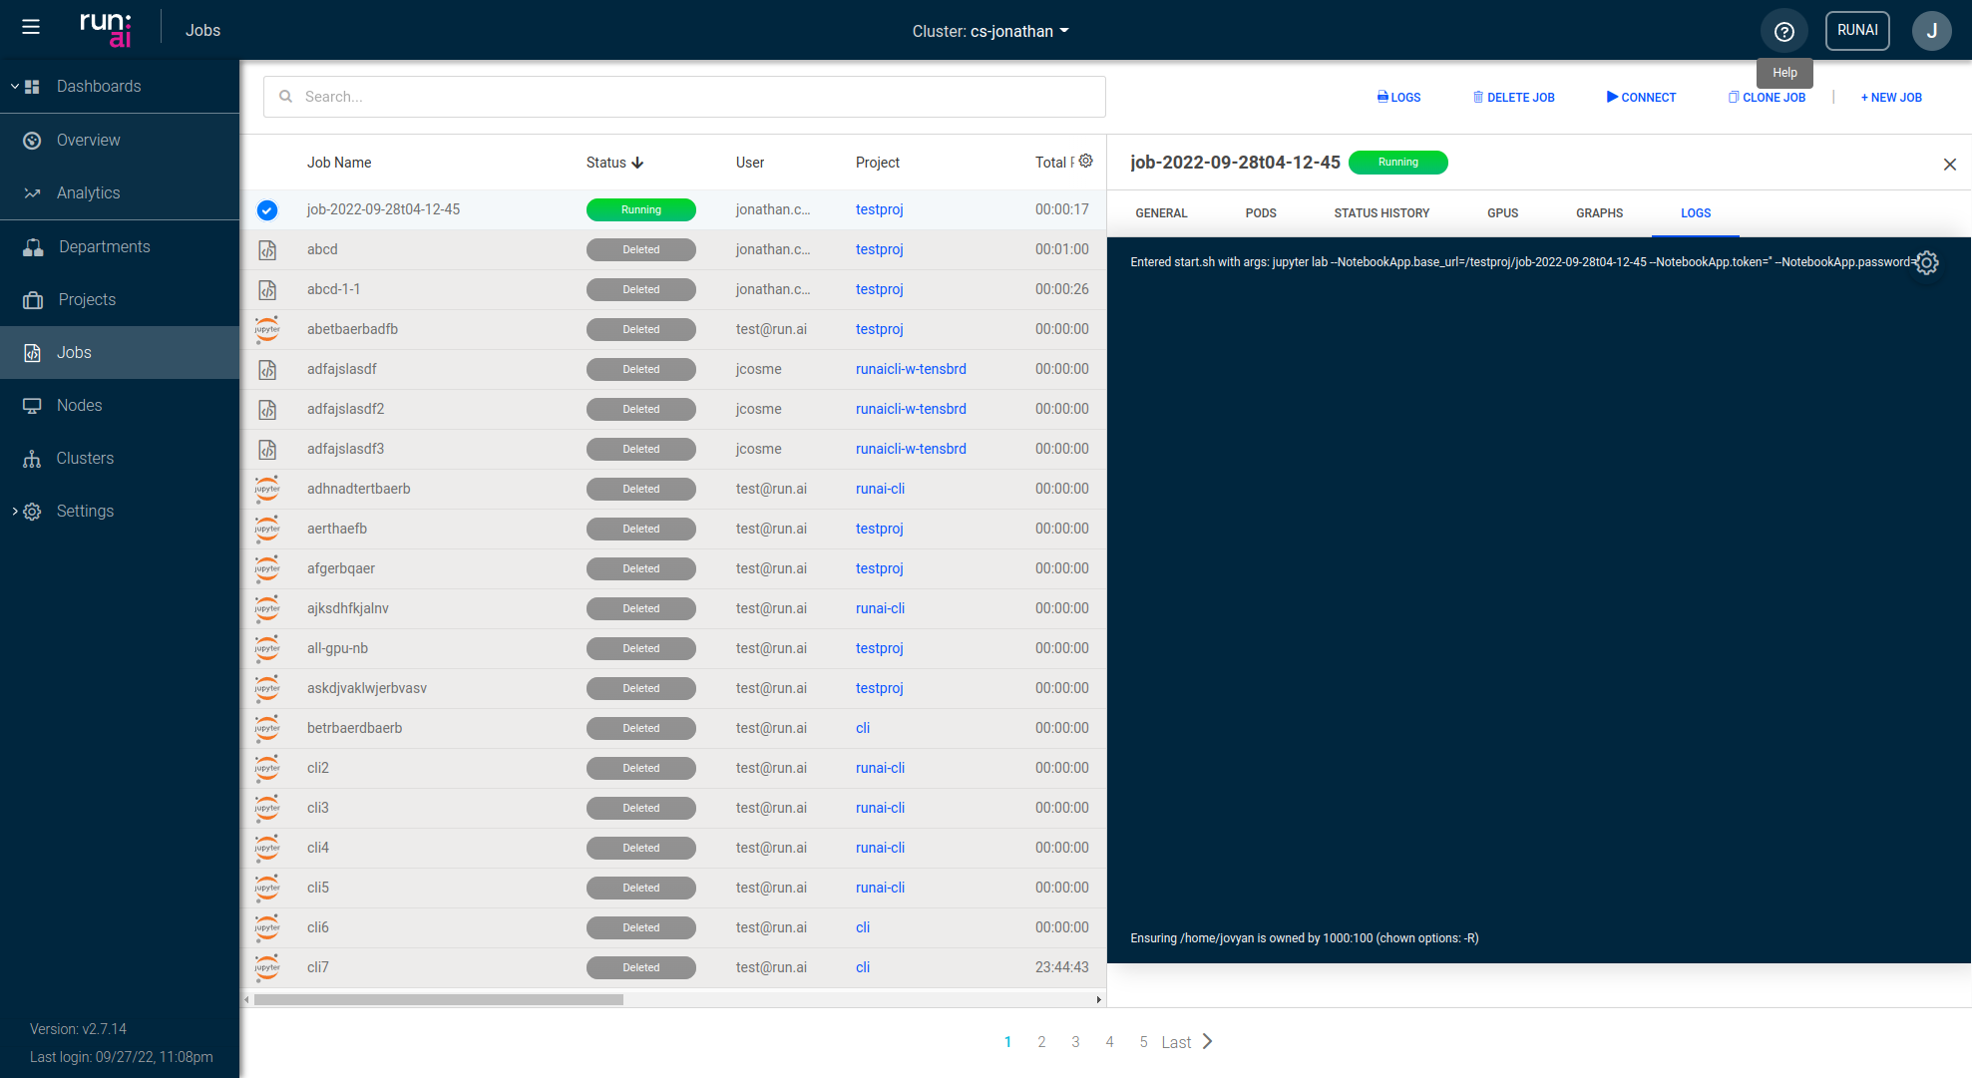
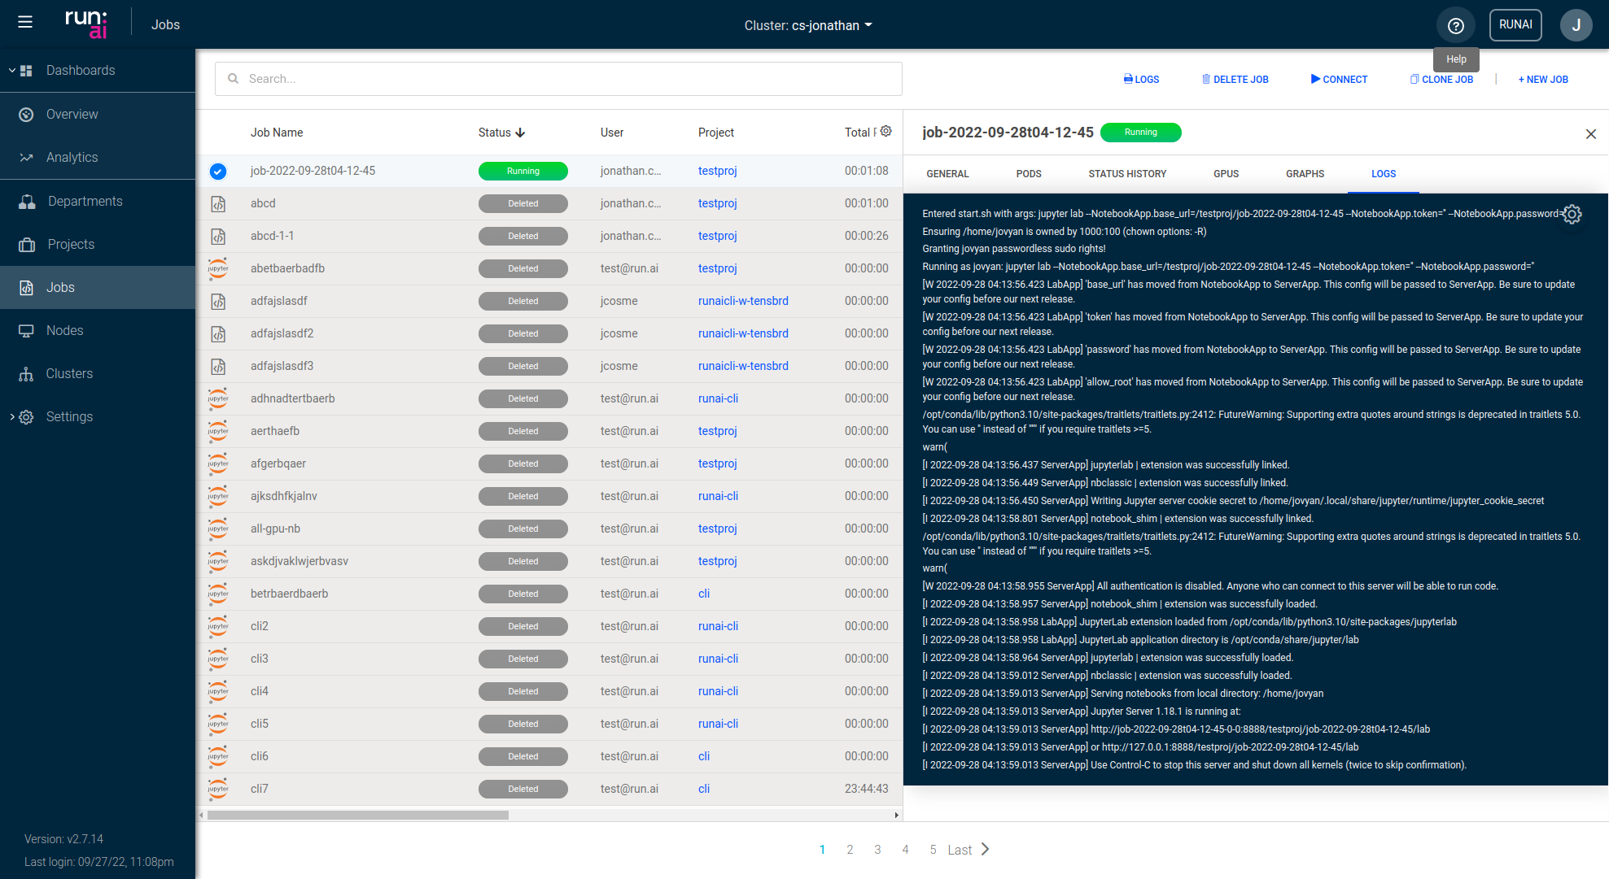
Step 3: Persistent .netrc file
1. Even though the job says “running,” seeing this line indicates that the notebook is still starting up
2. Wait until you see a line that says “Use Control-C to stop...” before clicking the connect button

Slide 25
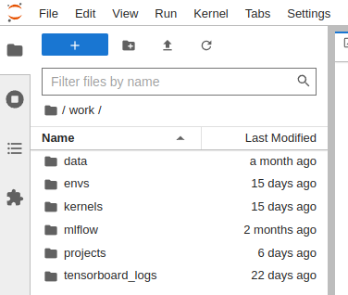
Step 3: Persistent .netrc file
After connecting, we should see all our files and folders within the work directory

Slide 26
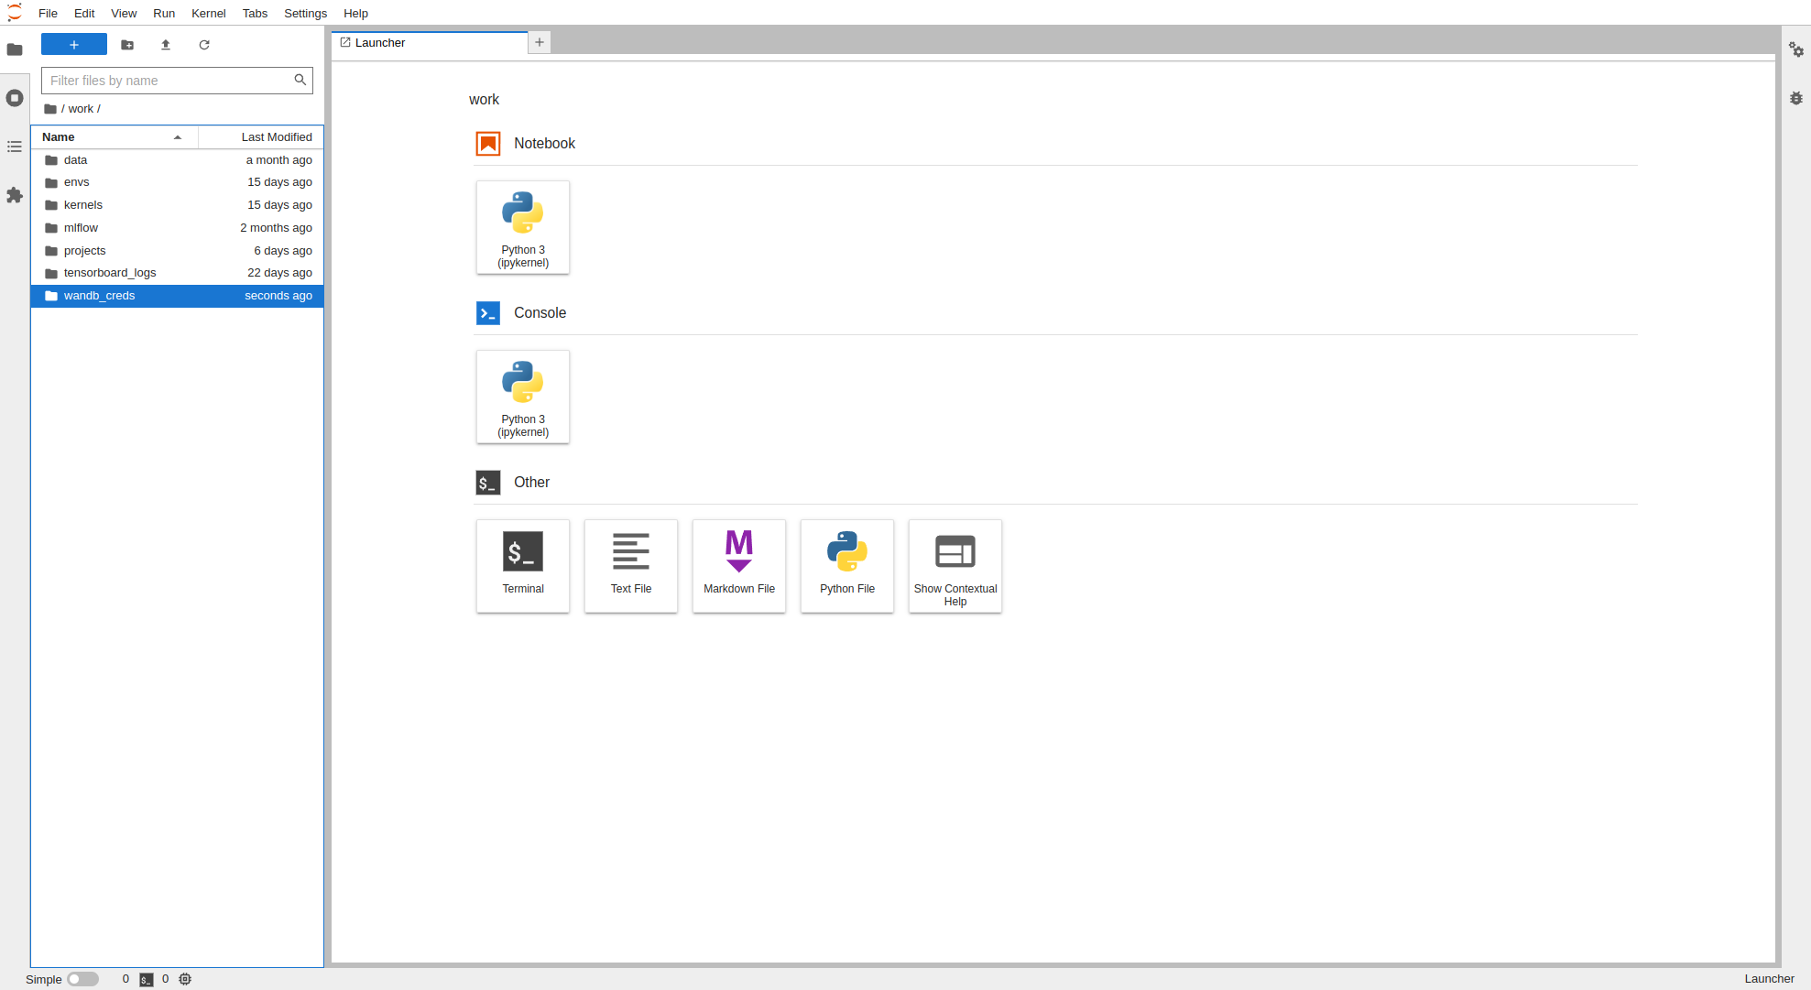
Step 3: Persistent .netrc file
Within the work directory, create a new folder called wandb_creds
1. create a new folder
2. call it wandb_creds

Slide 27
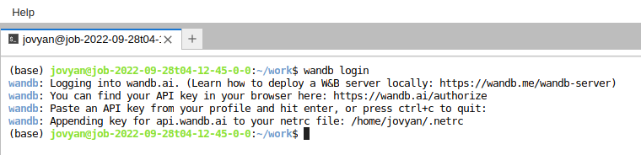
Step 3: Persistent .netrc file
run “wandb login” command to make the .netrc file
3. copy wandb API key
1. open a terminal window
2. run command
wandb login
4. paste API key into terminal when prompted
5. exit the terminal
exit
exit

Slide 28
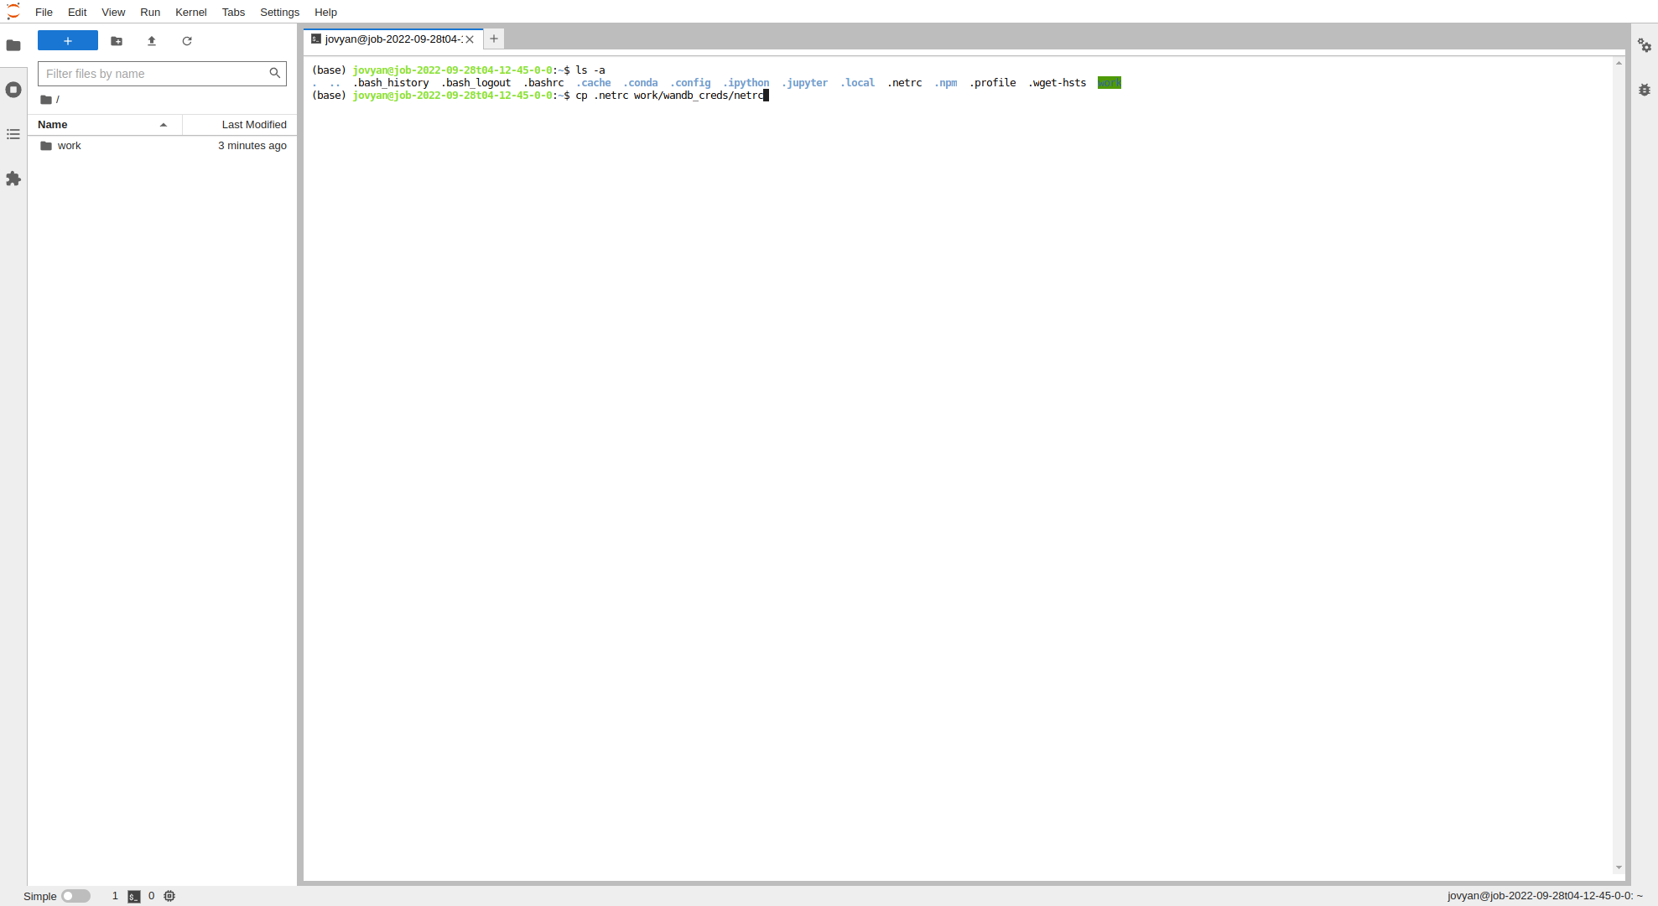
Step 3: Persistent .netrc file
confirm .netrc file was created
1. return to home directory
2. open a new terminal window
3. run command
ls -a
4. confirm .netrc file exists

Slide 29
Step 3: Persistent .netrc file
copy the .netrc file to the persistent wandb_creds folder.
(We will not put a period in front of the file name so that it will be visible to us)*
In the same terminal, run command
cp .netrc work/wandb_creds/netrc
*The jupyter lab UI does not show hidden files (files preceeded by a “.”). We copy it as a visible file (named “netrc” instead of “.netrc”) so that we do not mistake the wandb_creds folder for an empty folder, in the future.

Slide 30
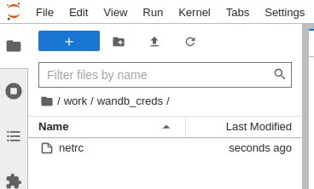
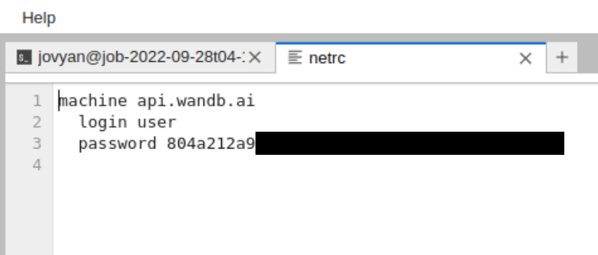
Step 3: Persistent .netrc file
confirm the copied file exists in our wandb_creds folder

Slide 31
Step 3: Persistent .netrc file
Now we can delete the job

Slide 32
Running
W&B with run:ai

Slide 33
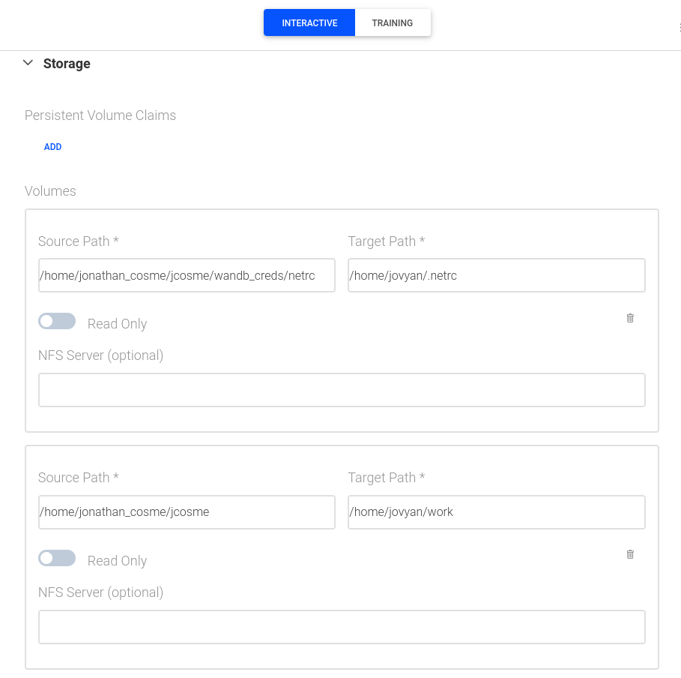
Running wandb jobs with run:ai
From now on, it is VERY important that we mount the persistent netrc file in our NFS, to the expected location of the netrc file in our image
in our case, the persistent netrc file is at:
/home/jonathan_cosme/jcosme/wandb_creds/netrc
and it should be mounted to:
/home/jovyan/.netrc
persistent netrc file in our NFS
expected location of netrc file in our image
Use the jonathancosme/base-root-wandb-tf image, and mount our NFS directory to the work directory as usual
normal NFS mount

Slide 34
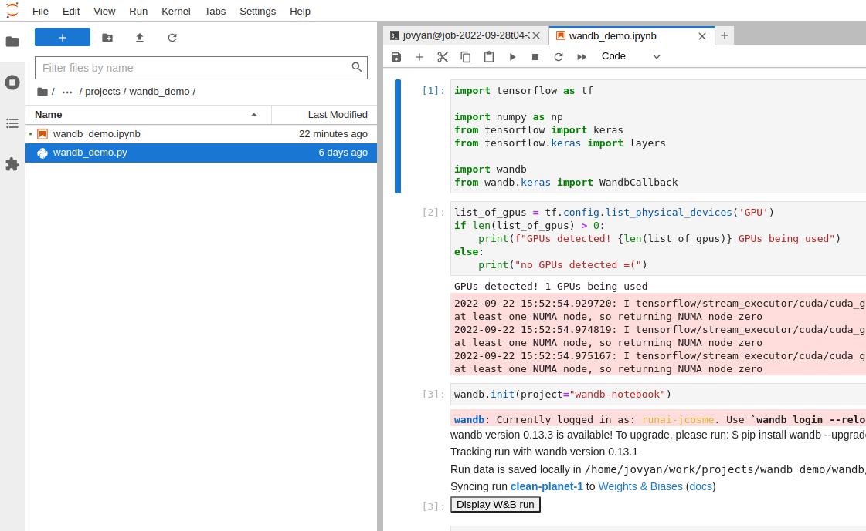
Jupyter notebook example
within our directory:
/home/jovyan/work/projects/wandb_demo
we have a wandb_demo.ipynb notebook.
Within the notebook, we create a wandb project called wandb-notebook

Slide 35
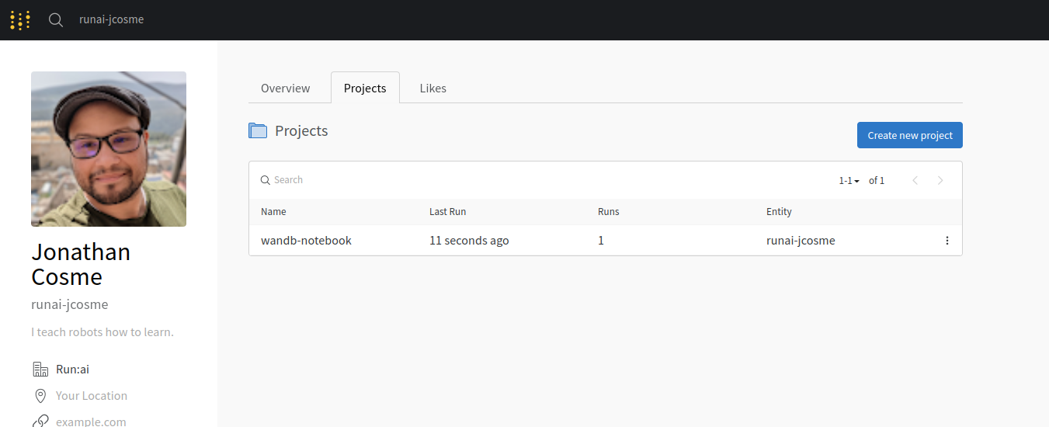
Jupyter notebook example
If we run the wandb_demo.ipynb notebook, we will see the updates on our wandb.ai account

Slide 36
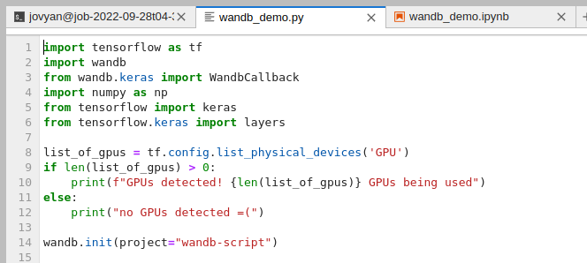
CLI example
within our directory:
/home/jovyan/work/projects/wandb_demo
we also have a wandb_demo.py python script.
Within the script, we create a wandb project called wandb-script

Slide 37
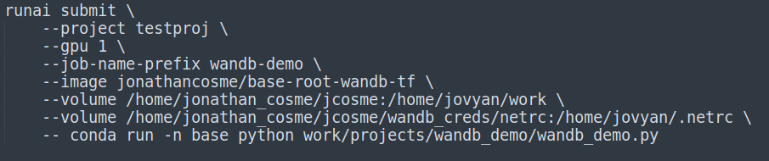
CLI example
we can run wandb_demo.py via the CLI with this command
here are the key highlights
use image with wandb installed
mount NFS to work directory
mount netrc file
command to run wandb_demo.py script

Slide 38

CLI example
After submitting the CLI command, we will see the updates on our wandb.ai account

Slide 39
Thank you!
contact@wandb.ai
|
www.wandb.ai

